Slide 1

Automated Driving Systems - Co-Simulating Autoware with Simulink®
Group members:
Alperen Kıral
Daniyal Ahmed
Phuris Khunphakdee
Advisors:
Steve Schäfer (MathWorks)
Dr. Christoph Hahn (MathWorks)

Slide 2
Overview
Introduction
Functionalities of Autonomous Vehicle
Co-Simulation of Autoware & Simulink
Automated Script for Autoware Modules
Manual Control of the Vehicle
Co-Simulation of Autoware & Simulink: Lane Change with Obstacles
Conclusion

Slide 3
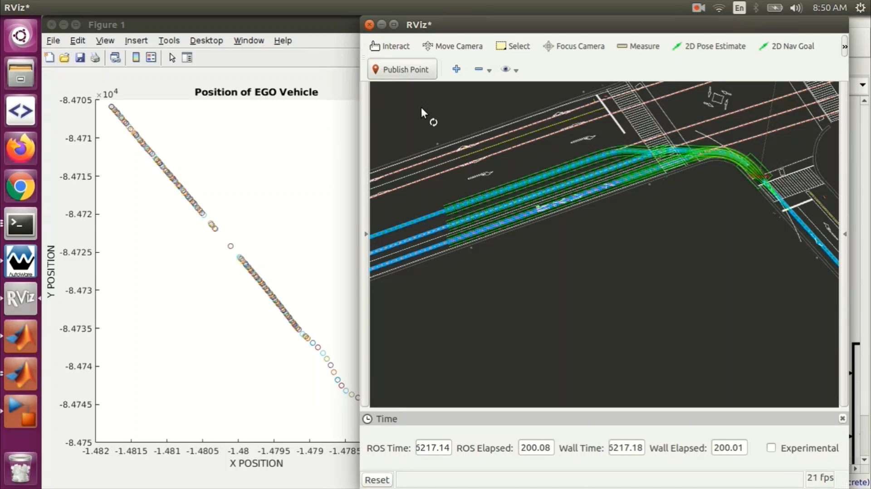

Slide 4
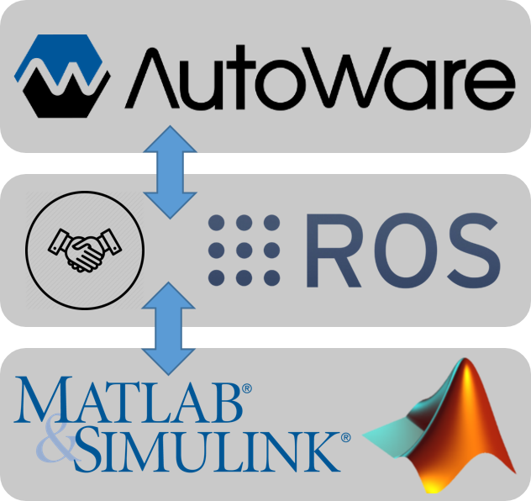

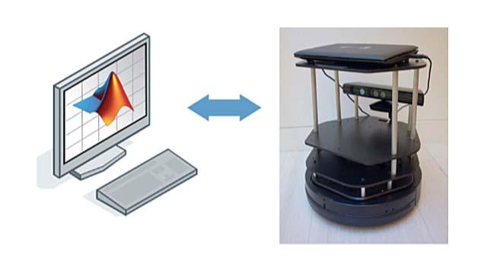
Introduction
Project Goals
To connect Autoware with MATLAB/Simulink using Robotics Operating System for co-simulation
To develop an automated-driving co-simulation example
ROS Toolbox

Slide 5
Introduction
Node 3
ROS Network
OBSTACLE AVOIDANCE
Subscribe
Node 1
Topic
CAMERA
Publish
IMAGE
Node 2
LANE CHANGE
Subscribe

Slide 6

Autoware Toolbox
Functionalities of Autonomous Driving Systems
SENSING
COMPUTING
ACTUATING
Step:
Voxel Grid Filter
?
?
Example:
An Open Loop
Notes:
Remind the audiences that the autonomous vehicle is abstracted in to sensing, computing and actuating module
Mention that we have tried the sensing module from Autoware Toolbox
2 more to try out

Slide 7
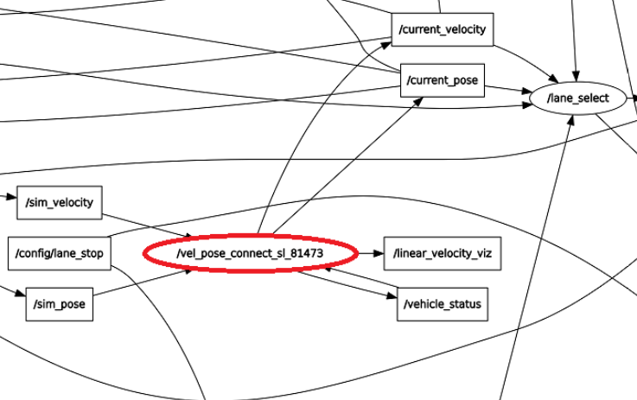
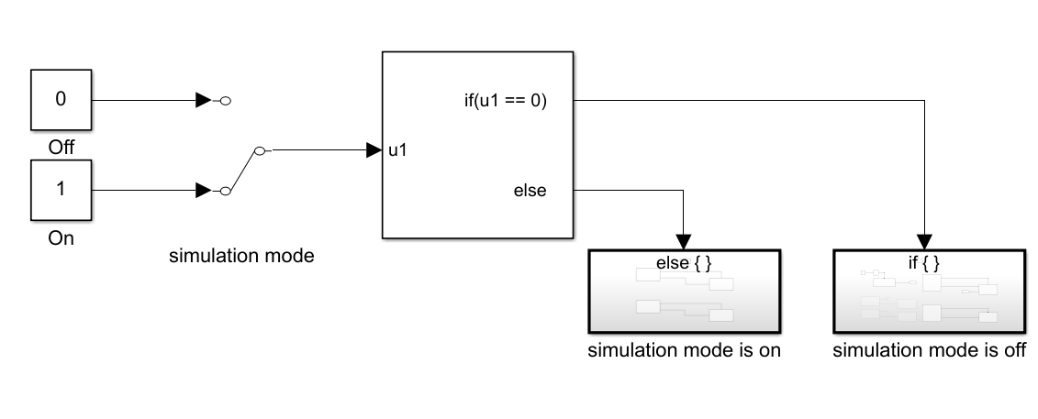
Autoware Toolbox
Computing Module
Determines the velocity and position of the vehicle vel_pose_connect
Using:
3-D Map Data captured by LIDAR
GNSS (Global Navigation Satellite System)
https://github.com/CPFL/Autoware-Manuals/blob/master/en/Autoware_UsersManual_v1.1.md#chapter-6---terminology
Notes:
Computing Module: Vel Pose Connect
What does it do?
Input data
Output data
Application of the output data

Slide 8
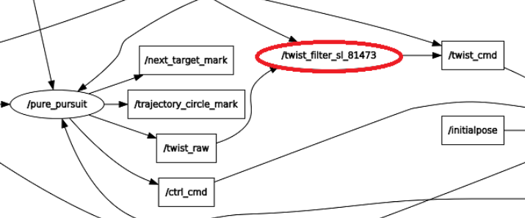
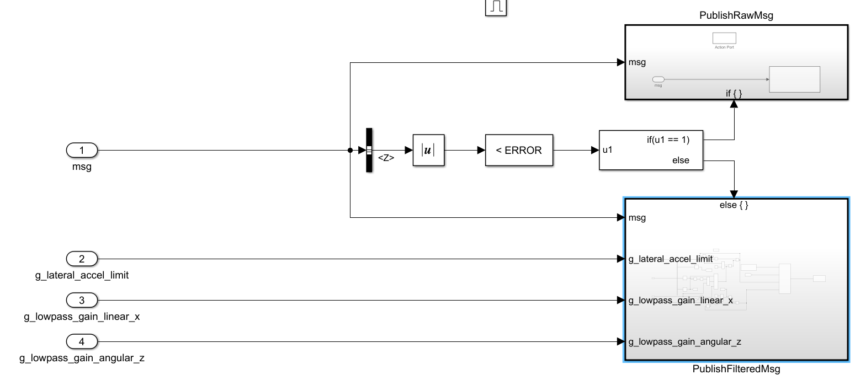
Autoware Toolbox
Actuation Module
To filter the actuation command
Twist Filter
Using:
Twist Command
Parameter:
Lateral Acceleration Limit
Notes:
Actuating Module: Twist Filter
What does it do?
Input data
Output data
Application of the output data

Slide 9
Autoware Toolbox
Functionalities of Autonomous Driving Systems
SENSING
COMPUTING
ACTUATING
Step:
Voxel Grid Filter
Vel Pose Connect
Twist Filter
Example:
A Closed Loop

Slide 10
Co-Simulation of Autoware & Simulink
ROS, QT
ROS Toolbox, Autoware Toolbox
Installation of Autoware
Installation of MATLAB/Simulink
Function Objective, Message Type
Node/Topic that provides the input
Message Type is provided by the Toolboxes
Function Implementation
Yes
Node/Topic that
needs the output
No
Create new message using ROS Custom Message Toolbox

Slide 11
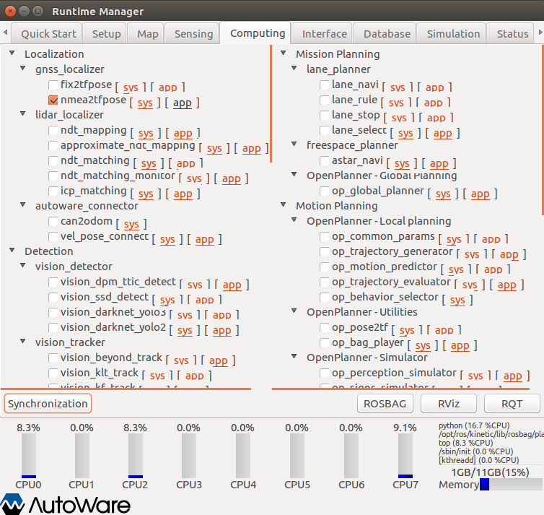
Automated Script for Autoware Modules
Autoware Runtime Manager
To turn on nodes by clicking the tick boxes
To load the data such as map or vehicle info
This is a slow process
Prone to human errors
How to avoid this?
Proposed solution: Automated Script
Python script:
Run all necessary nodes and topics, RViz, MATLAB
MATLAB script:
To run the MATLAB/Simulink models
Screenshot of Computing Tab from Autoware Runtime Manager

Slide 12
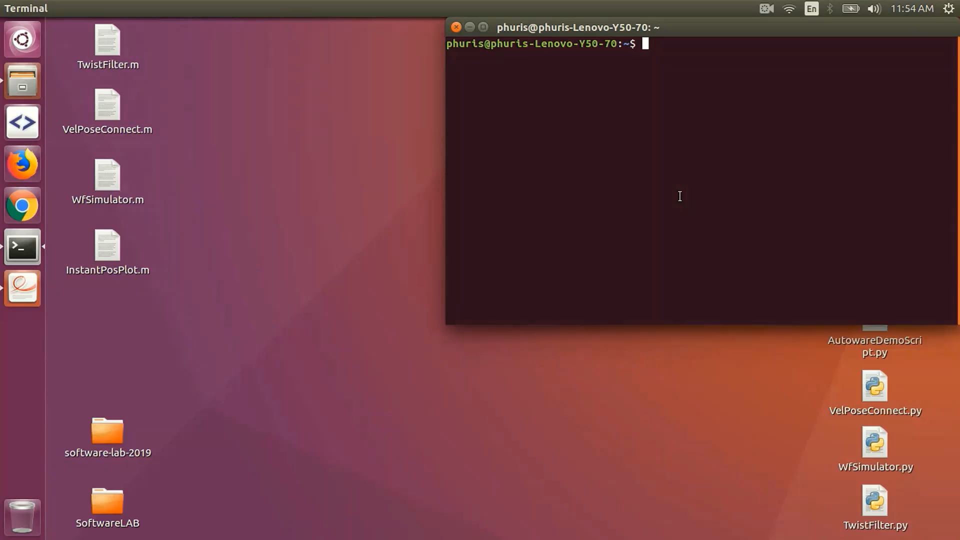
Automated Script for Autoware Modules

Slide 13
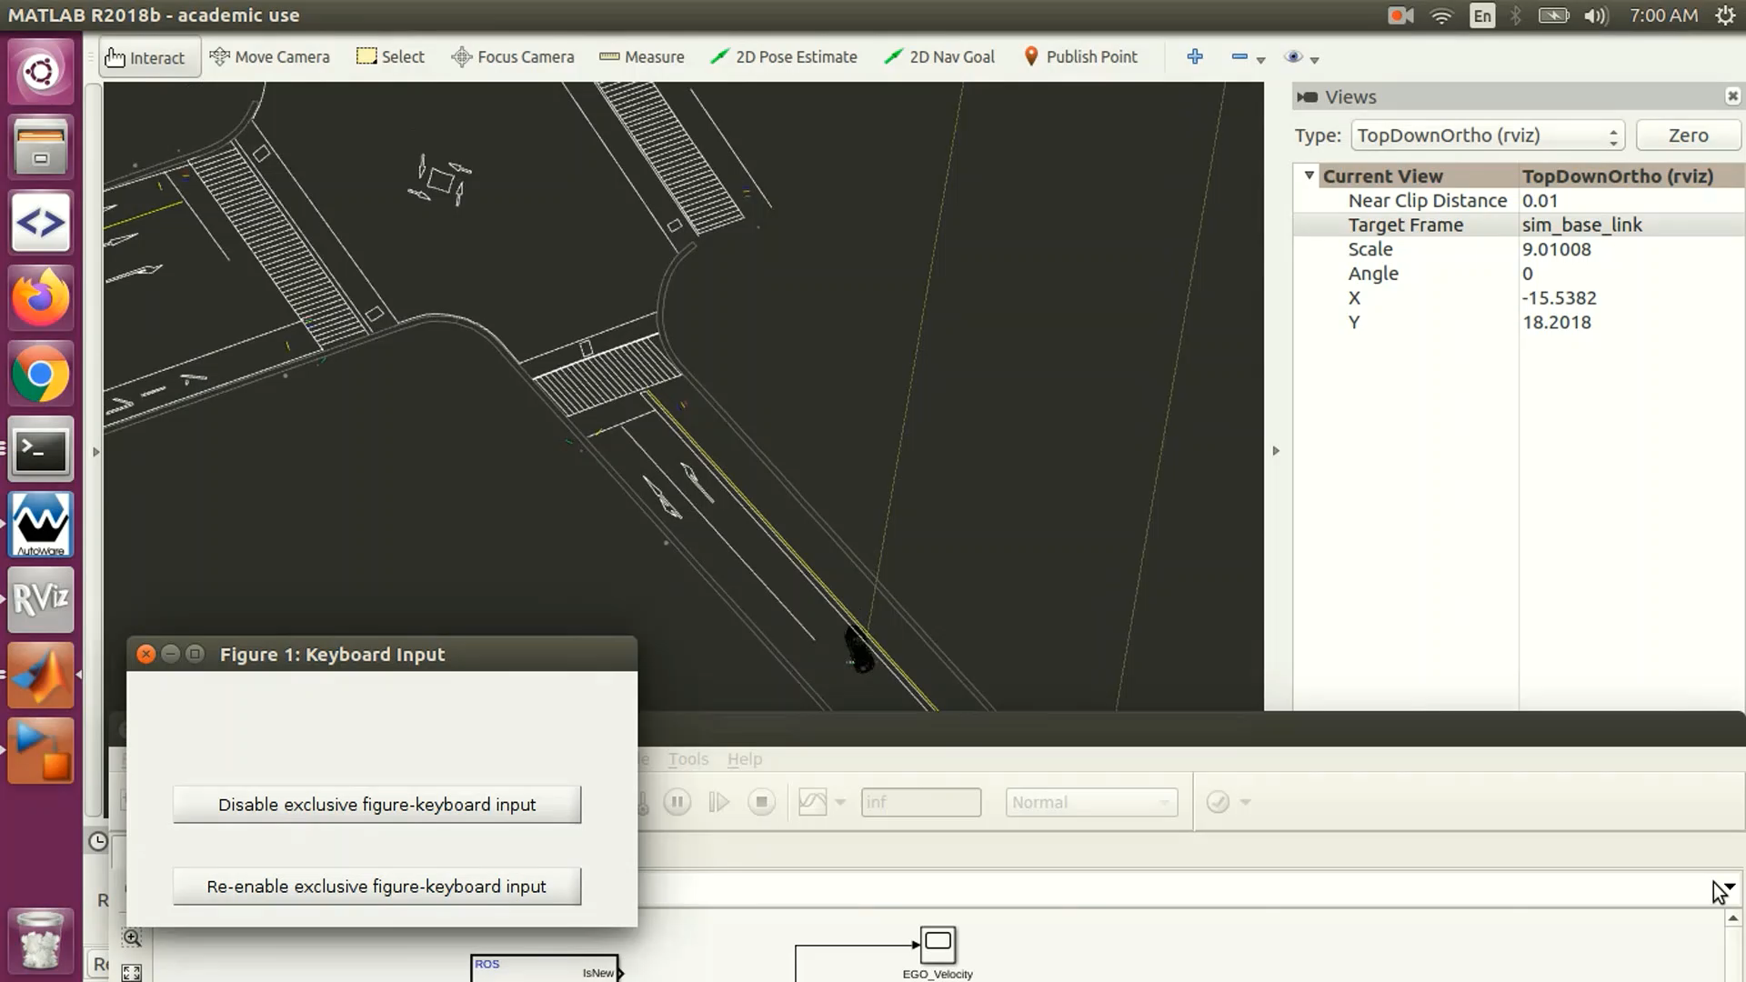
Manually Vehicle Controlling
Why manual vehicle control is relevant?
Failure of control algorithms

Slide 14
Manually Vehicle Controlling
/sim_pos
How to develop a manual mode?
Publish
position
/wf_simulator
/vehicle_cmd
Waypoint follower simulator
Vehicle command
Subscribe
Publish
/sim_vel
velocity
Keyboard control
Acceleration
Deceleration
Steering
Publish the command
Publish
Keyboard Control
Subscribe
From Simulink
Velocity control
Set a threshold value
Subscribe for current vehicle velocity
Prevent the velocity from exceeding the threshold value

Slide 15
Lane Change with Obstacles – Autoware & Simulink
MATLAB / Simulink & Autoware 1.8.0
All modules Sensing – Computing – Actuation
Extended co-simulation capabilities between MATLAB & Autoware
AUTOWARE
MODULES
SIMULINK
Global Path Planner
Vehicle Command
Lane Change
Vehicle Velocity & Position
Lateral Acceleration Limit
GNSS
MATLAB
Waypoint Follower

Slide 17
Conclusion
Increased co-simulation potential between MATLAB / Simulink & Autoware:
First co-simulation that imitates a real-life driving scenario
Lane Change with Obstacle
Automated/Scripted Co-Simulation
A user friendly experience
Speed increased by a factor of 3
Manually Controlling Vehicle
In case of failure of control algorithms
A comprehensive documentation
Guides user to run other examples of co-simulation
Detailed assistance for installation of softwares
https://gitlab.lrz.de/ge73xoh/software-lab---autoware.git
Notes:
This project serves as a way to develop autonomous functions from MATLAB/Simulink to be used in Autoware
The installation of Autoware, MATLAB/Simulink and related software and toolboxes are documented
The Benchmark functions in Autoware toolbox have been tried out for all main modules (Sensing, Computing and Actuation)
Demonstration of Autoware ROSBAG demo running and co-simulation of Autoware and MATLAB/Simulink functions from Autoware Toolbox are scripted to save time and efforts.
The Co-Simulation examples have been implemented in MATLAB and Simulink

Slide 18
References
Autoware ToolBox. (n.d.). Retrieved June 06, 2019, from
https://github.com/CPFL/Autoware_Toolbox
Autoware Foundation/Autoware. (n.d.). Retrieved June 06,2019, from
https://github.com/autowarefoundation/autoware
Kato, S., Tokunaga, S., Maruyama, Y., Maeda, S., Hirabayashi, M., Monrroy, A., . . . Azumi, T. (2018). Autoware on board: Enabling autonomous vehicles with embedded systems. Proc. of ICCPS 2018. 1-11. doi:10.1109/ICCPS.2018.00035
MATLAB/Simulink sample code suite for Autoware. (n.d.). Retrieved May 13, 2019, from https://github.com/CPFL/Autoware_Toolbox
Source Build. (2019, March 18). Retrieved from https://github.com/autowarefoundation/autoware/wiki/Source-Build
Tokunaga, S., Horita, Y., Oda, Y., & Azumi, T. (2019). IDF – Autoware: Integrated development framework for ROS-Based self-driving systems using MATLAB/Simulink. ASD 2019. doi:10.4230/OASIcs.ASD.2019.3

Slide 19
Thank you for your attention

